Slide 1
Introduction to Shared IT Services
Mac Users

Slide 2
AGENDA
Shared IT Services Introduction
Getting IT Support
Preparing for Migration to Shared IT Services
How will your Computer Change?
Find out more

Slide 3







What is Shared User Services?
IT you use every day:
Shared Services Introduction
desktop support
wireless
and
wired access
printing
file storage
software access
computer security

Slide 4




Why Shared Services?
Simple and Consistent IT Service
Improving quality of support by introducing consistency in IT across the university.
Moving toward a single credential university-wide: your WUSTL Key.
Streamlining support:
  One number
  One email
Shared Services Introduction

Slide 5
What are the features of the service?
One number to call for IT support.
Deskside support.
Software and security updates.
Wired and secure wireless network access.
Network printing and scanning.
WUSTL Key credentials and password reset.
Email address and mailbox.
Shared file storage.
Software access and self-service options.
Remote access to university resources.
Loaner equipment for travel, and to support ongoing business operations.
Shared Services Introduction
For a full description of service levels and features, see:
https://it.wustl.edu/basic-it-bundle

Slide 6


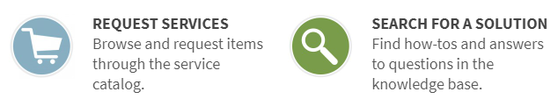
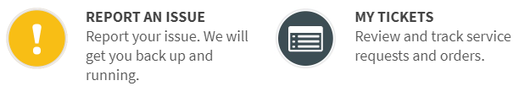
How do I get help?
314-933-3333
Hours
M – F 7:00am-5:30pm
24/7 for Business Critical issues
Support Information
ithelp@wustl.edu
http://it.wustl.edu

Slide 7
How long will it take to get help?
Initial Response Time Average (monthly):
Calls answered in 20 seconds or less
Email/Web requests response within 2 hours
After Hours Response Time Average (monthly):
Phone requests only
Response in 30 minutes or less for critical requests
Support Information

Slide 8
Follow Up and Resolution Targets
Follow Up
Resolution Target
Critical
  Global Issues
  Business critical issues
  Issues affecting multiple users, resulting in work stoppage
15 minutes
4 hours
Support Information
High
  Issues affecting individual or multiple users with no workaround available.
1 hour
1 business day
Medium
  Issues affecting multiple users with workaround available.
1 business day
3 business days
Low
  Issues affecting individual users with workaround available.
2 business days
5 business days

Slide 9

Our Service Commitment
All IT support and requests for services are logged and tracked in ServiceNow, our IT Service Desk system.
Reports run monthly track how we are meeting our Service Level Expectations for migrated departments.
Support Information
Request
Services
Search for
IT Solutions
Report an
IT Problem
View
Service Tickets
Notes:
Add link to customer guide

Slide 10
How should I prepare?
Know your WUSTL key.
Watch for email announcing your scheduled migration date and time.
Be sure your computer(s) are available at the specified date and time.
Preparing for Migration

Slide 11
How should I prepare?
Know your WUSTL key.
Your WUSTL key is what you use to log in to HRMS and the password you use for that username.
You will log into your device using your WUSTL key.
Preparing for Migration

Slide 12
How should I prepare?
Watch for email announcing your scheduled migration date and time
You may receive several emails from itmigration@wustl.edu.
Take note of the important information sent your way!
Contact itmigration@wustl.edu
Preparing for Migration
?

Slide 13
How should I prepare?
Your device needs to be available on migration date/time
You will need to be available to log in after computer migration is complete.
Contact itmigration@wustl.edu
Preparing for Migration
?

Slide 14

Operating System
How will my machine change?
You may choose to update to Catalina at the time of migration.
Reply to your User Migration Summary with the request to upgrade.
Upgrading your OS is available at any time in Self Service.
  Always back up your data before an OS upgrade!

Slide 15
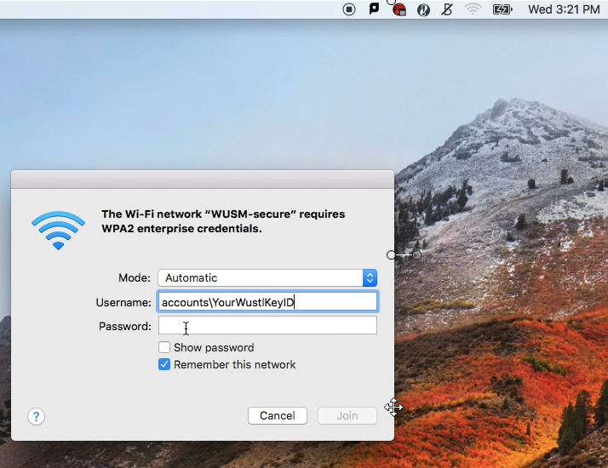
Logging In
How will my machine change?
After migration, log into your Mac with your usual password.
Be sure you are connected to WUSM-secure, or hardwired into the network.
WUSM-secure:
Username: accounts\wustlkey
Example: accounts\j.doe

Slide 16
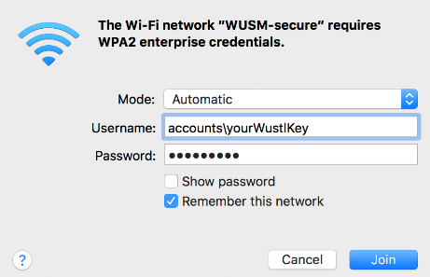
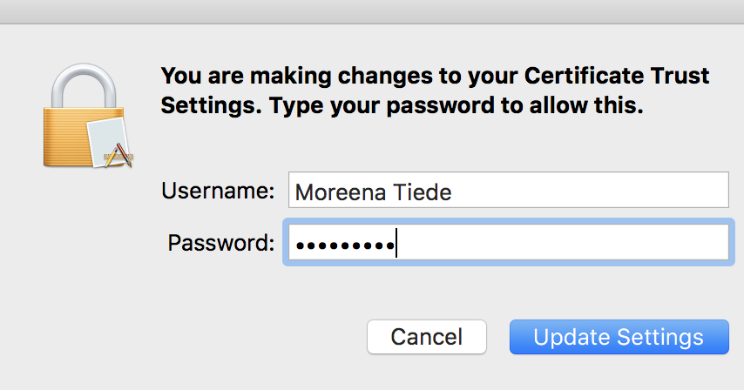
Macs: Wireless Networks
How will my machine change?
WUSM-secure is available across campuses.
Log in with your WUSTL key (preceded by accounts\).
You may need to verify the network certificate the first time you log in.
  Click continue to verify.
  Enter your Mac password (should be same as WUSTL Key password if you have run Enterprise Connect already).
  Click Update Settings.
WUSTL Key account login
Notes:
WUSM-secure will be renamed and will be replacing WUSTL-encrypted
Settings???? Which are restored?
Available printers restored. Quick Guide includes instructions for setting default printer in Win 10 settings. Techs available to assist on migration day.

Slide 17
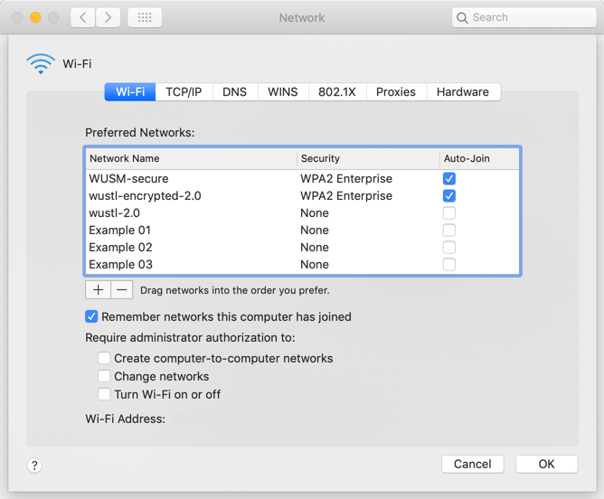



Prioritize Wireless Networks
How will my machine change?
You can ensure that your Mac prioritizes the connection to WUSM-Secure by moving it to the top of the Preferred Networks list.
System Preferences > Network > WiFi
*Requires Administrator Rights
Notes:
How to do this:
Click on System Preferences
Click on Network
Click on WiFi
Click on the lock to authenticate as administrator
Click on Advanced
Click and Hold on WUSM-Secure
Drag WUSM-Secure to the top of the Preferred Networks List
Click on OK
Can Also Search for Network using Spotlight Search
CMD + Space
Type in Network
Click on Network
Click on WiFi
Click on the lock to authenticate as administrator
Click on Advanced
Click and Hold on WUSM-Secure
Drag WUSM-Secure to the top of the Preferred Networks List
Click on OK

Slide 18
Enterprise Connect
How will my machine change?
Syncs your Mac password and WUSTL key password.
  Why?
  Increased password security for your computer.
  Ease of access to university resources.
  How?
  Open Applications folder.
  Select Enterprise Connect.
  Enter your WUSTL Key password.
  Authorize sync by entering your current computer password.
  After successful sync, you will log into your Mac with your WUSTL Key password.
Notes:
Emphasize that username is not changing, only password

Slide 19

Self Service
How will my machine change?
Your dock will contain a new icon for Self Service.
Self Service allows you to install software and network printers.
Log in with your WUSTL Key.

Slide 20

Macs: Security
How will my machine change?
FireAMP is installed on Macs for anti-virus and anti-malware protection.
If you previously installed a different anti-virus program, it will be removed in order to avoid conflicts.
No other software on your Mac will be removed!
Notes:
Mac users in path have the Microsoft AV for Mac

Slide 21

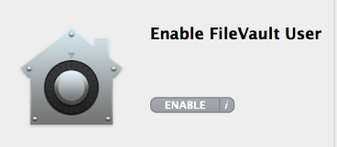
Macs: Security
How will my machine change?
IMPORTANT!
Macs are encrypted using File Vault.
  If your mac was not previously encrypted, you will need to enable yourself as a File Vault user before you restart or shutdown your computer. Failure to do so will mean you cannot log back into your machine after restart!
    Enable File Vault through Self Service.
    Log into Self Service with WUSTL Key.
    Click Enable button (twice).
    Enter your WUSTL Key password.
For a video walking you through these important steps, please go to
http://it.wustl.edu/mac
Notes:
Mac users in Pathology have the Microsoft AV for Mac

Slide 22

Macs: Menu Bar
How will my machine change?
1
2
3
4
The menu bar (upper-right) will display:
Alertus icon (emergency notification).
The FireAMP anti-virus icon.
Enterprise Connect icon
The BeyondTrust remote support tool.
  BeyondTrust allows for remote support of your machine.
  Allows IT support to log in remotely assist or troubleshoot your machine.
Notes:
Add enterprise connect icon

Slide 23

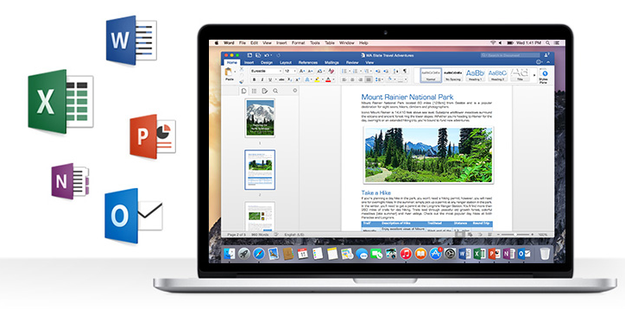

Macs: Office 2016
How will my machine change?
Office 2016 installed.
Office 2011 still available.
Why move to Office 2016?
  Increased Security
  Compatibility with Office 365 Applications
  Improved Performance
  Designed specifically for Macs, with support for retina displays
Find help on Office 2016 at
it.wustl.edu/how-to
Notes:
Remind how to find 2016 if 2011 on dock

Slide 24
Macs: Printing
How will my machine change?
Post-migration
Add printers through Self Service. If you need to add a printer that you do not see (from another department), call or email 314-933-3333 or email ithelp@wustl.edu.
If you attempt to use a printer shortly after you have added it in Self Service, you may be prompted to log in with your WUSTL key.
Printer functions are unchanged.
Notes:
Add video of adding printer.
Optional: changing mac user id to match wustl key id
Settings???? Which are restored?
Available printers restored. Quick Guide includes instructions for setting default printer in Win 10 settings. Techs available to assist on migration day.

Slide 25

More information
Find out more
https://it.wustl.edu/how-to/
https://it.wustl.edu/basic-it-bundle/
Notes:
Remember to show websites if you have time.

Slide 26

Questions?

